Slide 1

IMAGE CLASSIFICATION USING CONVOLUTION NEURAL NETWORK
Presented by:
Aabhushan Pokharel 45/BCT/2071
Prabin Bhusal 63/BCT/2071
Rajesh Mahato 67/BCT/2071

Slide 2
Introduction

Slide 3
Background
Human visual cortex is capable of recognizing and classifying a vast amount of objects that it encounters
Artificial Neural Network analogues Natural Neurons
Convolutional Neural Networks especially adapted for this task

Slide 4
Problem Statement
It’s becoming impossible for anyone to manually classify thousands of images.
If an automated system that can classify them is built, then this problem could be solved.

Slide 5
Objectives
To implement convolutional neural network to build an image classiﬁcation system

Slide 6
Application
Automated image organization
In stock photography websites for effective tagging
In large image databases

Slide 7
Features
Possible to classify different images in upto 10 classes

Slide 8
Feasibility Analysis
No additional hardware purchases required
The technical implementation of the software being developed is covered by existing technology
Resources are available as open source as well as the existence of an online community also helps in this regard
Can be developed with standard CPU

Slide 9
System Requirements
Hardware Requirements
Software Requirements
Intel i5 processor (recommended)
8GB RAM (recommended)
Nvidia GPU (optional)
Windows 7/8/10 64 bit or Mac OS X Lion or higher
Python 3.5
Keras 2.1 library
OpenCV library
Sklearn library
Numpy library

Slide 10
Literature Review

Slide 11
AlexNet
In 2012, it won the ImageNet Large Scale Visual Recognition Challenge (ILSVRC)
The AlexNet used a subset of ImageNet dataset which included 15 million labeled high resolution images belonging to roughly 22,000 categories.
Architecture contains eight layers with weights. First ﬁve layers are convolutional layers and the remaining three are fully connected

Slide 12
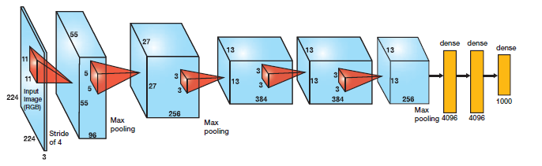
AlexNet Architecture

Slide 13
METHODOLOGY

Slide 14
Algorithm
Step 1: Start
Step 2: Load data
Step 3: Define the image pixel, channel, number of classes and epochs
Step 4: Perform data pre-processing
convert to grayscale
resize image to standard size
normalize the data

Slide 15
Algorithm (continued)
Step 5: Label the data for training the model
Step 6: Shuffle the data to feed the model
Step 7: Split the data for training, validation and testing
Step 8: Define architecture of the network
Step 9: Visualize model configuration

Slide 16
Algorithm (continued)
Step 10: Train the model
Step 11: Predict the class
Step 12: Generate the plot of loss and accuracy
Step 13: Stop

Slide 17
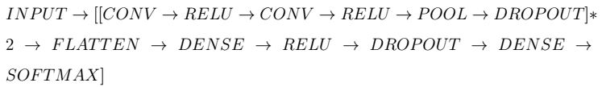
Architecture

Slide 18
Process Description
Image converted to grayscale and resized to 128x128 pixels
Normalized by dividing value by 255
3x3 filter passed through entire image to extract feature map
First two convolutional layer uses 32 3x3 filters and the latter two use 64 3x3 filters

Slide 19
Process Description (contd..)
ReLU applied after each convolution and 2x2 maxpool utilized
Batch size used was 16 due to memory contraints
Number of epochs 20-30 yields high training accuracy
RMSprop used as optimizer
Dense layer with softmax function to generate probabilities

Slide 20
EXPCTED OUTPUT

Slide 21
Work Completed
Preprocessing of data as required was completed
Data trained in four categories with the model
Training/Validation split with the same dataset
Plot of accuracy and loss for both training and validation generated

Slide 22
Work Remaining
Further research for network optimization
Network needs to be scaled up for large dataset and up to 10 categories
Trained weights need to be stored in file to avoid retraining
An accessible user interface needs to be developed

Slide 23
Problem Encountered
Difficulty in understanding core concept of Convolutional Neural Network
Data needs to be trained at every launch
Validation accuracy and loss are not optimal

Slide 24
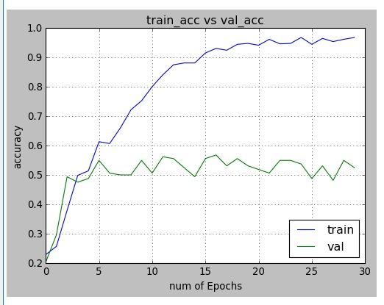
Current Output

Slide 25
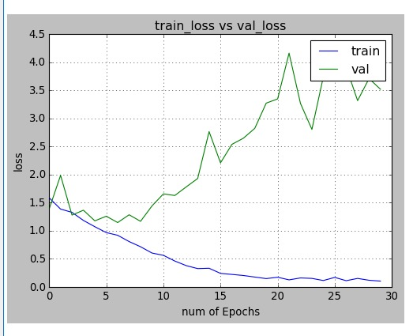
Current Output (contd..)

Slide 26
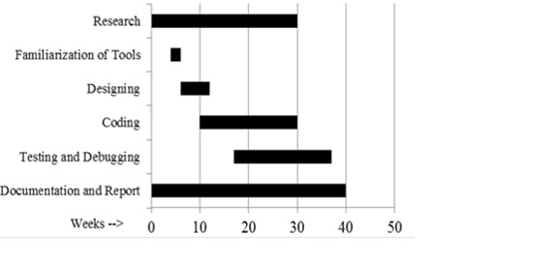
Work Schedule

Slide 27
THANK YOU!

